Slide 1
An Introduction to GENI Tools
Sarah Edwards
GENI Project Office

Slide 2
Outline
GENI Tools: Behind the scenes
Other GENI resource reservation tools
Omni, jFed, Flack, Portal
GENI support for automating resource reservation
Custom images, install and execute scripts
Instrumentation and Measurement Tools
GENI Desktop and LabWiki

Slide 3
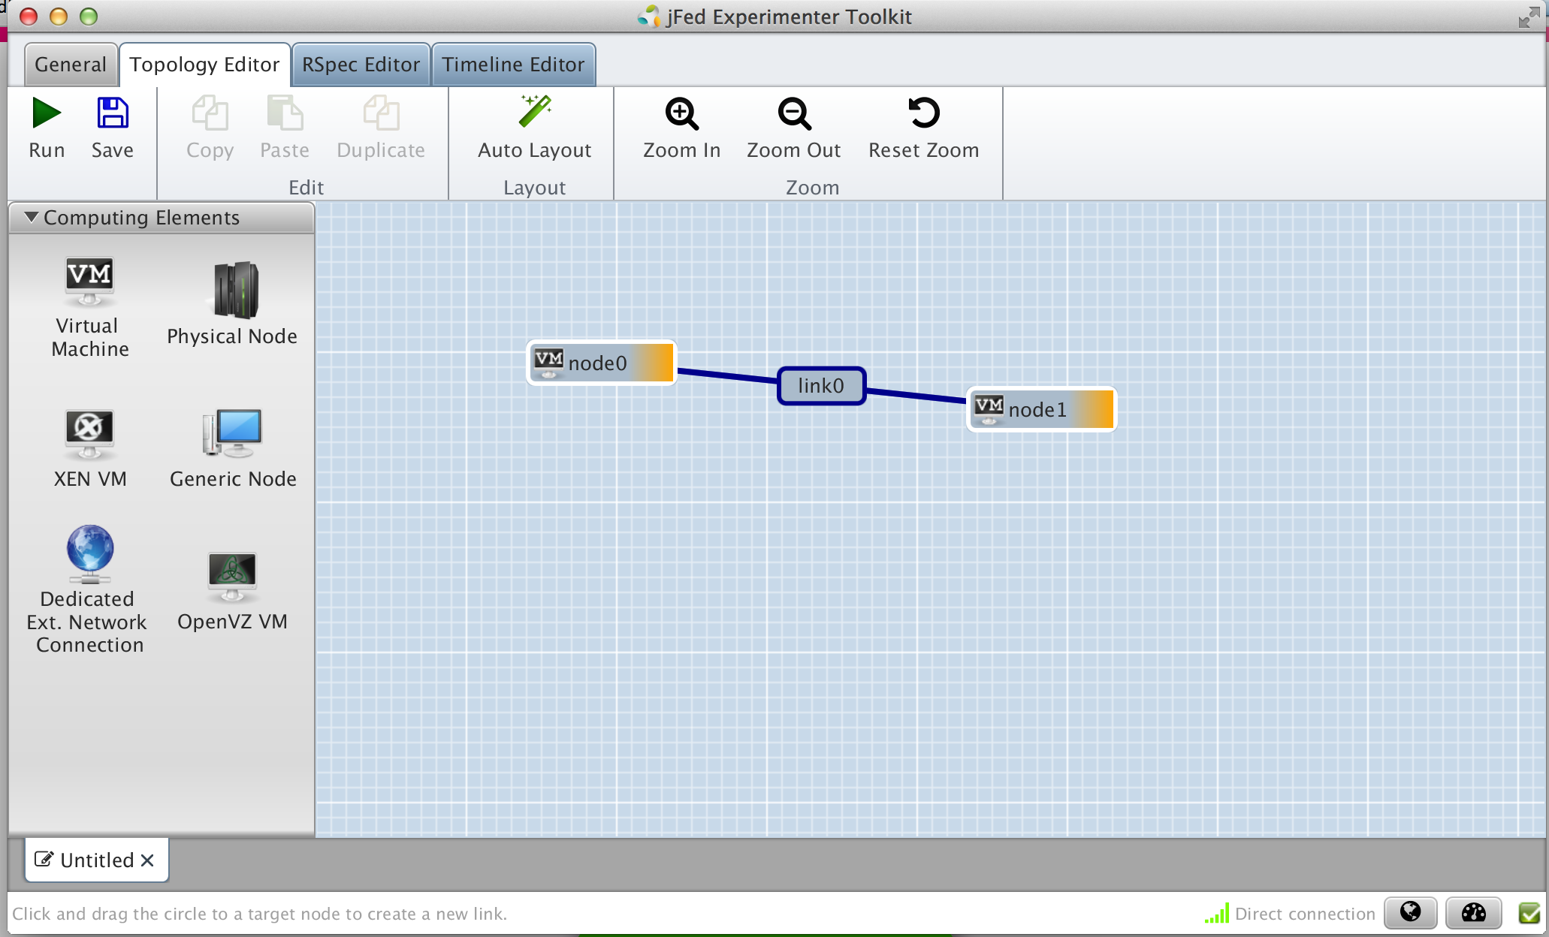
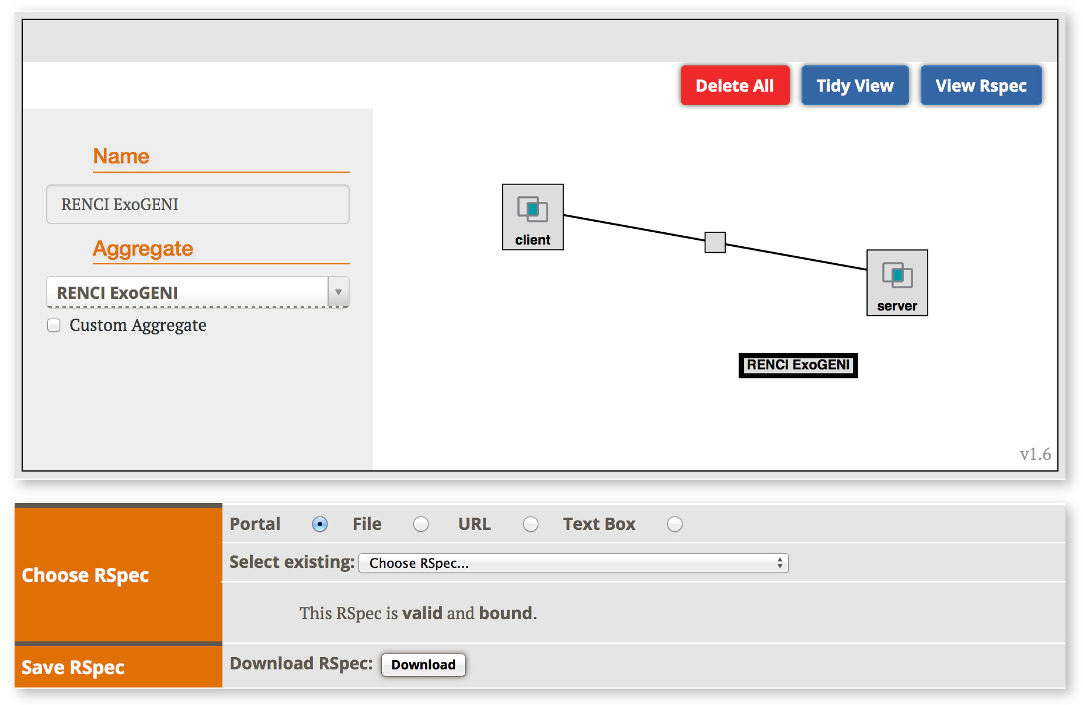
In Part 1 You Learned…
To run a simple experiment
Logging into the Portal
Using a tool such as Jacks (or jFed) to reserve resources
Logging into resources
Manually installing software in resources
Control interface vs. data interfaces
jFed
Jacks

Slide 4
In Part 2 You will Learn…
What happens behind the scenes when you run an experiment on GENI
New concepts:
GENI Resource Specifications (RSpecs)
GENI Aggregate Manager API (GENI AM API)

Slide 5
Tutorial Objectives
By the end of this tutorial you should:
Feel comfortable running experiments on GENI
Have a basic understanding of how GENI works
Later exercises may skip some of the basic steps in this tutorial to focus on new material
You may be given an RSpec to use rather than have you create one
You may use slices that have already been created and resources added to them
For a description of the GENI concepts covered, see:
http://groups.geni.net/geni/wiki/GENIConcepts

Slide 6
GENI Resource Specifications (RSpecs)
RSpecs are XML documents that describe resources
VMs, links, etc.
RSpec for a virtual machine with one interface:
<?xml version="1.0" encoding="UTF-8"?>
<rspec type="request” xsi:schemaLocation="http://www.geni.net/resources/rspec/3 … xmlns="http://www.geni.net/resources/rspec/3">
<node client_id="server" component_manager_id="urn:publicid:IDN+instageni.gpolab.bbn.com+authority+cm”>
<sliver_type name="emulab-openvz"/>
<interface client_id="server:if0”> </interface>
</node>
</rspec>

Slide 7
RSpecs
RSpec documents are exchanged by experimenter tools (e.g. Jacks) and aggregates
Aggregates use RSpecs to describe what they have – Advertisement RSpecs
Experimenters use RSpecs to describe the resources they want – Request RSpecs
Aggregates use RSpecs to describe the resources allocated to an experimenter – Manifest RSpecs

Slide 8
The GENI AM API
Experimenter tools and aggregates talk to each other using the GENI Aggregate Manager API (GENI AM API)
What do you have?
I have …
ListResources(…)
I would like …
Advertisement RSpec
You have …
CreateSliver(Request RSpec, …)
Aggregate
Manager
Experimenter
Tool
What do I have?
Manifest RSpec
You have …
ListResources(SliceName, …)
Manifest RSpec

Slide 9
Putting it all Together…
When you drag and drop resources on to the Jacks/jFed canvas, a request RSpecs for these resources is created
To view the request RSpec…
When you click Add Resources/Run, createSliver is called on the aggregates
I would like …
jFed
Jacks

Slide 10
Putting it all Together…
Tool periodically calls sliverStatus on the aggregates to check on the status of your request
When sliverStatus shows:
Resources are ready to use, when they turn green
jFed
Jacks

Slide 11
Putting it all Together…
What do I have?
ListResources with a slice name returns a manifest RSpec
Manifest includes names and ports used to ssh into VMs
Tool uses this information to help you log into your resources
You have …
jFed

Slide 12
Putting it all Together…
When you delete resources, tool calls deleteSliver on aggregates

Slide 13
Outline
GENI Tools: Behind the scenes
Other GENI resource reservation tools
Omni, jFed, Flack, Portal
GENI support for automating resource reservation
Custom images, install and execute scripts
Instrumentation and Measurement Tools
GENI Desktop and LabWiki

Slide 14
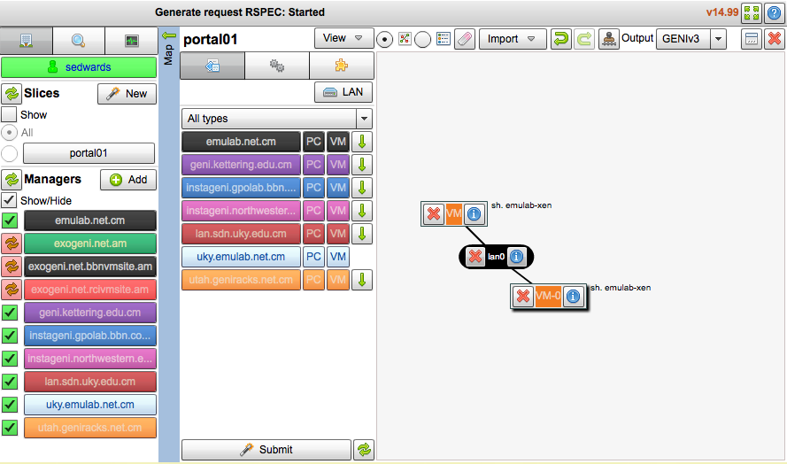
GENI Resource Reservation Tools
All GENI resource reservation tools speak the AM API and RSpec…
Next we’ll explore a command line tool …
Flack
Jacks/Portal
Hosted
omni
$ omni createsliver aliceslice myRSpec.xml
INFO:omni: -----------------------------------
INFO:omni: Completed createsliver:
Options as run:
aggregate: https://www.emulab.
framework: pgeni
native: True
Args: createsliver aliceslice myRSpec.xml
Result Summary: Slice urn:publicid:IDN+pgeni
Reserved resources on https://www.emulab.net/p
Saved createsliver results to aliceslice-man
INFO:omni: ===================================
jFed
Local

Slide 15
Omni: Resource Reservation tool
A command line experimenter tool
Useful for making AM API calls on aggregates
Written in and scriptable from Python
Works with aggregates that implement the GENI AM API
InstaGENI and ExoGENI racks, ProtoGENI, PlanetLab, FOAM (OpenFlow AM)
$ omni.py createsliver aliceslice myRSpec.xml
INFO:omni:Loading config file omni_config
INFO:omni:Using control framework pgeni
INFO:omni:Slice urn:publicid:IDN+pgeni.gpolab.
expires within 1 day on 2011-07-07
INFO:omni:Creating sliver(s) from rspec file
INFO:omni:Writing result of createsliver for
INFO:omni:Writing to ‘aliceslice-manifest-rspe
INFO:omni: -----------------------------------
INFO:omni: Completed createsliver:
Options as run:
aggregate: https://www.emulab.
framework: pgeni
native: True
Args: createsliver aliceslice myRSpec.xml
Result Summary: Slice urn:publicid:IDN+pgeni
Reserved resources on https://www.emulab.net/p
Saved createsliver results to aliceslice-man
INFO:omni: ===================================
http://trac.gpolab.bbn.com/gcf/wiki/Omni

Slide 16
Omni Command Workflow
Create
Slice
Create
Sliver
Cleanup
Repeat for each
aggregate
Repeat for each
aggregate
createslice
getversion
deletesliver
renewslice
listresources
listmyslices
createsliver
sliverstatus
Legend: AM API command

Slide 17
Sample Omni Commands
omni –a aggregatename listresources
omni –a aggregatename createsliver slicename requestRSpec
omni –a aggregatename sliverstatus slicename
omni –a aggregatename listresources slicename
omni –a aggregatename deletesliver slicename
A useful utility (distributed with Omni):
readyToLogin –a aggregatename slicename
Gives you the ssh commands you need to log into your nodes
readyToLogin parses the output of listresources and sliverstatus to determine the hostname, port and username for the ssh commands

Slide 18
Configure omni

Slide 19
Configuring Omni
Omni reads a configuration file omni_config to:
Find locations of ssl certs and ssh key files
ssl certs are used to secure communication between Omni and the aggregates
ssh key pairs are used log into compute resources
Find standard nicknames for aggregates
e.g. you can refer to the InstaGENI rack at NYSERNet as nysernet-ig
instead of
https://instageni.nysernet.org:12369/protogeni/xmlrpc/am

Slide 20
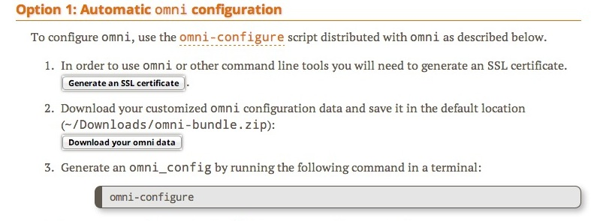
Creating an Omni Config File
Download the GENI bundle from the GENI Portal
2. Run omni-configure in a terminal window
$ omni-configure

Slide 21
Omni Hands-On
Find Login information
readyToLogin –a aggregatename slicename
Delete an existing reservation
omni --useSliceAggregates deletesliver slicename

Slide 22
Outline
GENI Tools: Behind the scenes
Other GENI resource reservation tools
Omni, jFed, Flack, Portal
GENI support for automating resource reservation
Custom images, install and execute scripts
Instrumentation and Measurement Tools
GENI Desktop and LabWiki

Slide 23
Custom Images
Custom Images
Standard images are available
Snapshot standard images to create custom images

Slide 24
Install/Execute Scripts
Install scripts
Place a tarball (.tgz file) on a publicly accessible webserver
Specify the url and a destination (e.g. /tmp) in your RSpec
Specify the name of a command or a script to run at resource reservation time
The file at the url is downloaded, decompressed and placed in the specified destination

Slide 25
Outline
GENI Tools: Behind the scenes
Other GENI resource reservation tools
Omni, jFed, Flack, Portal
GENI support for automating resource reservation
Custom images, install and execute scripts
Instrumentation and Measurement Tools
GENI Desktop and LabWiki

Slide 26
Named Data Networking … also known as Content Centric Networking
PRINCIPLE
Focus on what you need; not on where you find it
TODAY
Must know the location of information (aka URL)
Search engines map the what to the where
Most Internet information look-ups start with search engines
CCN (NDN)
New network architecture reflects Internet usage
CCN protocols cache data at all network levels
routers, hosts

Slide 27
Experiment Setup
Researcher (rschr) fetches data by name
(e.g. precip data from 1901/01/01 to 1901/01/02). Requests
not in cache forwarded to router.
Collaborator (collab) fetches data by name. Requests
not in cache forwarded to researcher.
Intermediate node (router). Requests
not in local cache forwarded to data source.
Data Source (dsrc1): Holds precipitation data from
1 Jan 1901 to 31 Jan 1902 (data from NOAA)

Slide 28
Conclusions
Tips
Select tools that work best for what you are doing
Automation of experiments is really important
In General….
Start small
Change one thing at a time
Automate as you go
Then scale up

